Slide 1

Effectiveness of Investment Incentives in Developing countries Evidence and Policy Implications
Dr. Sebastian James
The World Bank Group

Slide 2
Plan of the Presentation
The Incentives Framework
The econometric evidence
Current literature
Investment Climate Department research
The survey evidence
Previous surveys
Investment Climate Advisory’s surveys
Incentives for Public Goods
Cost of Incentives
Political Economy
Policy advice

Slide 3
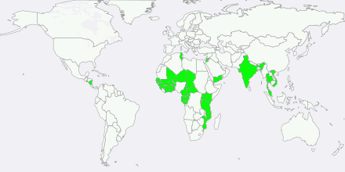
Incentives and Tax - Project scope
This project studies incentives in 41 countries across 4 continents

Slide 4
Plan of the Presentation
The Incentives Framework
The econometric evidence
Current literature
Investment Climate Department research
The survey evidence
Previous surveys
Investment Climate Advisory’s surveys
Incentives for Public Goods
Cost of Incentives
Political Economy
Policy advice

Slide 5
Tax Expenditures around the world
The cost of tax incentives are non-trivial in many countries

Slide 6
Prevalence of Tax Incentives around the World
 | Number of Countries Surveyed | Tax holiday/Tax exemption | Reduced Tax rate | Investment allowance/Tax credit | R&D Tax Incentive | Super-deductions | SEZ/Free Zones/EPZ/Freeport | Discretionary process
East Asia and Pacific | 12 | 92% | 75% | 67% | 83% | 33% | 92% | 83%
Eastern Europe and Central Asia | 16 | 88% | 38% | 25% | 31% | 0% | 100% | 38%
Latin America and the Caribbean | 25 | 88% | 32% | 52% | 12% | 4% | 72% | 40%
Middle East and North Africa | 15 | 80% | 40% | 13% | 0% | 0% | 80% | 40%
OECD | 33 | 21% | 36% | 64% | 76% | 21% | 67% | 33%
South Asia | 7 | 100% | 43% | 71% | 29% | 71% | 71% | 43%
Sub-Saharan Africa | 45 | 78% | 62% | 78% | 11% | 18% | 64% | 82%
Tax Incentives in one form or the other are prevalent in all regions of the World

Slide 7
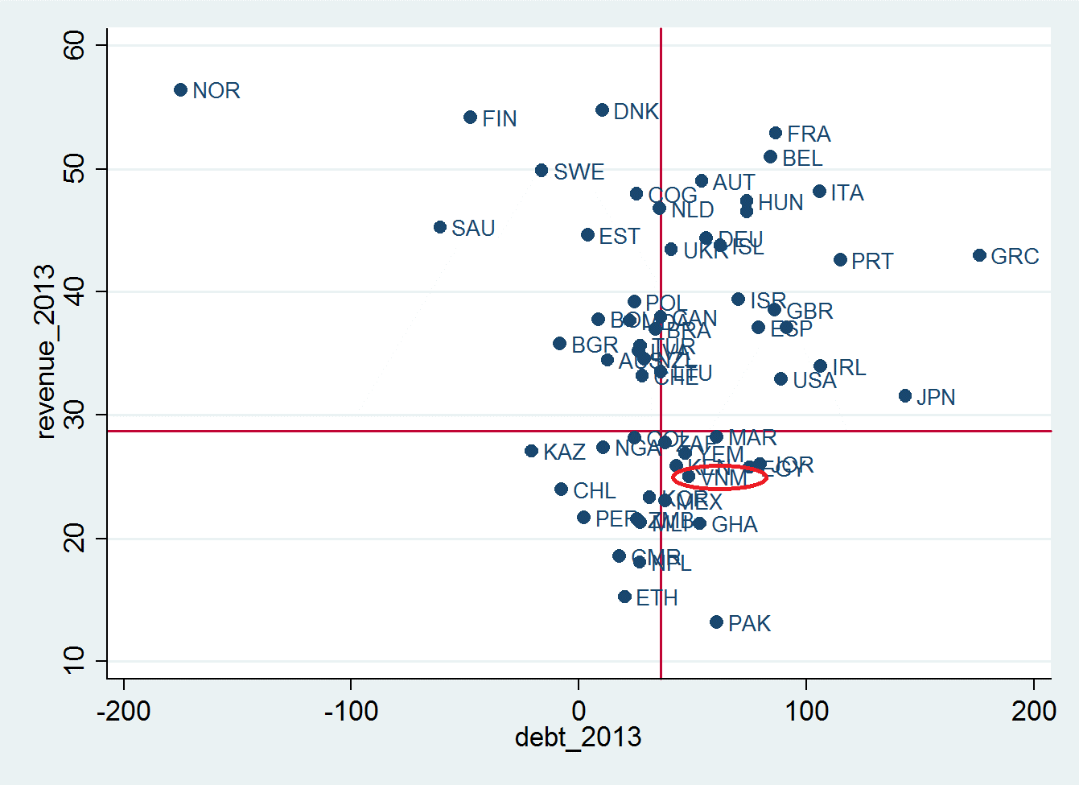
Revenue versus Debt
Vietnam is in the High Debt - Low Revenue quadrant

Slide 8
Revenue vs Fiscal Balance
Vietnam occupies the High (-ve) Fiscal Balance – Low Revenue quadrant

Slide 9
Prevalence of Tax holidays 2000 v. 2014
 | Number of Countries surveyed (UNCTAD 2000) | Number of countries with Tax Holidays
 |  | in 2000 | in 2014
East Asia and Pacific | 7 | 7 | 6
Eastern Europe and Central Asia | 3 | 3 | 2
Latin America and the Caribbean | 10 | 10 | 8
Middle-East and North Africa | 4 | 4 | 4
OECD | 8 | 6 | 3
South Asia | 2 | 2 | 2
Source: UNCTAD (2000) and James (2014)

Slide 10
Incentives Framework
The Benefits and Costs of an Incentive Policy
Revenue rise due to increased investment
Social benefits from increased investment
Lost revenue from investments that would have been made anyway
Indirect cost of incentives
+
>
+
Social Benefits include cleaner environment, better skills, better health, etc.

Slide 11
Plan of the Presentation
The Incentives Framework
The econometric evidence
Current literature
Investment Climate Department research
The survey evidence
Previous surveys
Investment Climate Advisory’s surveys
Incentives for Public Goods
Cost of Incentives
Political Economy
Policy advice

Slide 12
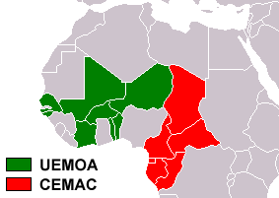
The Effectiveness of Tax incentives in West/Central Africa
Notes:
First case is on selection of 12 Western and Central African countries.
That share the same currency, the CFA Franc:
WAEMU/UEMOA:
1. Benin
2. Burkina Faso
3. Cote d’Ivoire
4. Niger
5. Mali
6. Senegal
7. Togo
(Guinee-Bissau)
CEMAC:
1. Cameroun
2. Central African Republic
3. Congo
4. Gabon
5. Tchad
(Guinee Equatoriale)

Slide 13
Impact of Investment Code on FDI

Slide 14
Finding in UMEOA/CEMAC Case Study
General Tax Holiday 
Investment ⬄
Export Tax Holiday 
Investment ⬄ 
Complexity Incentives 
Investment 
Legal Guarantees 
Investment 
Notes:
Note that I did not the admin variable, because it is highly correlated with the number of regimes, as a result it is hard to tell which one is working, but the second one is still significant if the other one is in.
Have a slide ready with table to show-off

Slide 15
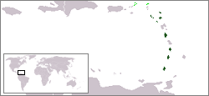
Organization of Eastern Caribbean Countries
The Effectiveness of Tax incentives for Tourism Investment in the Caribbean
Notes:
Next we looked at the incentives for the tourism sector in the Caribbean
We are looking here at 7 small Islands: Anguilla, Antigua and Barbuda, Dominica, Grenada, St Kitts and Nevis, St Lucia, St Vincent and the Grenadines.
They are all very attractive for tourism, they are all very small, they are competing for the same tourism industry
So one can expect that tax competition is strong in this setting, level playing field.

Slide 16
FDI inflows into the Caribbean
When Antigua increased the tax holiday from 5 years to 25 years in 2003 investments responded. However was this investment taken away from other countries ?

Slide 17
Almost no impact of lowering Effective Tax Rates on FDI in low IC countries
Source: James and Van Parys, 2009

Slide 18
Top inbound and outbound FDI
 | Average FDI inbound (% of GDP) (2003-2012) |  | Average FDI outbound (% of GDP) (2003-2012)
British Virgin Islands | 3564.3 | British Virgin Islands | 3613.5
Cayman Islands | 412.3 | Cayman Islands | 266.7
Marshall Islands | 113.5 | Cook Islands | 137.1
Liberia | 38.8 | Liberia | 51.2
Luxembourg | 28.1 | Luxembourg | 32.1
Anguilla | 26.7 | China, Hong Kong SAR | 27.7
China, Hong Kong SAR | 26.4 | Belgium | 13.4
Congo | 21.3 | Panama | 11.3
Montenegro | 20.6 | Marshall Islands | 10.3
Mongolia | 19.2 | Singapore | 10.2
Singapore | 19.1 | Iceland | 10.0
Sao Tome and Principe | 18.0 | Switzerland | 9.6
Saint Kitts and Nevis | 17.9 | Netherlands | 7.9
Belgium | 15.6 | Ireland | 7.2
Antigua and Barbuda | 15.3 | Sweden | 6.4

Slide 19
Plan of the Presentation
The Incentives Framework
The econometric evidence
Current literature
Investment Climate Department research
The survey evidence
Previous surveys
Investment Climate Advisory’s surveys
Incentives for Public Goods
Cost of Incentives
Political Economy
Policy advice

Slide 20
Investor Motivations to Invest
Survey asked about three most critical factors for investment decisions*
(Answer in Percent)
*: Open-ended question, multiple answers possible
**: Number of businesses surveyed in respective countries; ***: Includes ease of import/export, employing labor , etc.
Source: Investment Climate Department, 2009

Slide 21
Investors who would NOT have invested without tax Incentives

Slide 22
US Outbound FDI and METR in host countries
FDI in Manufacturing responds significantly but not FDI in mining which depends on the availability of the resource

Slide 23
Typology of FDI and response to Tax Incentives
Type of Investment | Factors that drive it | Response to investment incentives
Natural Resource/Skill-seeking FDI | Location of Natural Resources/Skills | Low response. FDI driven primarily by non-tax factors.
Market-seeking FDI | Market potential Market dimensions Income per-capita Customer specific preferences Kind of goods and services to be provided | Low response. Level playing field between firms is critical (same tax system for all competitors).
Strategic Asset-seeking FDI | Acquiring Strategic Assets Brands and Market positioning Know-how Technology Distribution Networks Human Capital | Low response. FDI is driven by the location of the asset. However lower taxes on capital gains reduces the costs of the transfer of these assets.
Efficiency-seeking FDI | Lower Costs Mostly export oriented Availability of skills at a Low cost skills Close to markets Low relocation costs | High response to tax incentives. Firms are expected to compete globally, hence the lower the costs, the better their ability to compete globally.

Slide 24
Results from Surveys
Author | Focus of survey | Conclusion |  | Did incentives influence Investment level? (% saying yes)
Investment Climate Advisory (FIAS)—investor motivation surveys | Cambodia | Redundancy ratio for incentives (Would have invested even if Incentives were not provided) | 22%
 | Guinea (2012) |  | 92% | 6%
 | Jordan (2009) |  | 70% | 28%
 | Kenya (2012) |  | 61% | 11%
 | El Salvador (2013) |  | 37% | 13%
 | Nicaragua (2009) |  | 15% (51% for non-exporting firms outside free zones) | 17%
 | Serbia (2009) |  | 71% | 6%
 | Tanzania (2011) |  | 91% | 8%
 | Tunisia (2012) |  | 58% | 25%
FIAS | Vietnam (2004) |  | 85% | -
FIAS | Thailand (1999) |  | 81% | -
Nathan Associates | Mozambique (2009) |  | 78% | 13%
Guisinger and Associates (1985) | Investment incentives and performance requirements for export-oriented firms |  | 33%
Reuber (1973) | FDI and market orientation |  | 52% for export-oriented firms
Mckinsey—MNE investment in developing economies (2003) | Business process outsourcing (BPO) and automobile sectors in India (2003) | Incentives not among top 3 factors driving location decisions
Fortune/Deloitte and Touche (1997) | Business location study | Taxes ranked 13th of 26 factors in importance for investments
G–30 (1984) | Study of 52 multinational corporations covering half of world’s FDI stock | Incentives ranked 7th in importance for investments

Slide 25
Plan of the Presentation
The Incentives Framework
The econometric evidence
Current literature
Investment Climate Department research
The survey evidence
Previous surveys
Investment Climate Advisory’s surveys
Incentives and Public Goods
Cost of Incentives
Political Economy
Policy advice

Slide 26
Incentives and Public Goods
Investment incentives are recommended when
investment assets available to general public
This is just another way to pay for public goods
investments generate positive externalities
Encouraging Green Technologies
Upgrading skills of workers
Anchor investments (slippery slope but have to be justified)
*: First best is to tackle the tax competition issue

Slide 27
Tax competition
Race to the bottom
Evidence shows that countries compete
by lowering tax rates
by providing more attractive tax holidays (Klemm and Van Parys, 2009)
Thought this cannot be extended to other kinds of tax incentives
Fighting off one country with the other is part of a strategy followed by some private sector
However, in many cases the final choice is already made
‘Winning’ countries in many cases suffer from the winners curse/buyers remorse, having given up too much
Only a coordinated response could avoid such a race to the bottom (Ex. agree on common minimum criteria)
There is also evidence of a race to the top !

Slide 28
More Regional Coordination/Harmonization of tax systems
Countries need to avoid HARMFUL TAX COMPETITION
There are several degrees of Tax Harmonization
Does not mean that all the taxes should be the same
Countries could agree to coordinate (EAC pre-budget meeting of Finance Ministers)
Countries could agree on a Code of Conduct
Countries could define Rules (that can be enforced) on the use of Tax Incentives (EU State Aid Rules)
Fiscal Union (common tax base and rates across the union)

Slide 29
Lessons learned on harmonizing tax incentives
The key to success is not to be too ambitious
Provide list of prohibited tax incentives (example, Countries shall not offer Tax Holidays longer than 10 years)
Provide reasonable exceptions to the general strict rule of full harmonization
Have an enforcement mechanism

Slide 30
Plan of the Presentation
The Incentives Framework
The econometric evidence
Current literature
Investment Climate Department research
The survey evidence
Previous surveys
Investment Climate Advisory’s surveys
Incentives and Public Goods
Cost of Incentives
Political Economy
Policy advice

Slide 31
Cost of Incentives
Time and money spent by businesses to lobby the government for incentives
Time and money spent by businesses to qualify for and receive tax incentives
Revenue lost to illegal activity
Additional costs for tax authorities responsible for administering tax incentives
Distortion costs
Notes:
Revenue lost to illegal activity, such as
from businesses that do not qualify for tax exemptions but falsify information to do so,
or indirect revenue lost through businesses that do not qualify for tax incentives that (illegally) use tax-exempt entities to source goods.

Slide 32
Costs of obtaining incentives
Percent |  | Mozambique (60 respondents) |  | Jordan (61 respondents) |  |  |  | Serbia (50 respondents) |  |  | Nicaragua (71 respondents)
Did obtaining incentives delay project implementation?
 |  |  |  |  |  |  |  |  |  |  | 20% by 2–12 months 1% by more than 1 year
Did obtaining incentives add to project costs?
What were the main additional costs?
 | Additional senior management time: 18% Loss of business: 15% |  |  |  | Not an issue |  | Additional senior management time : 6% Additional consulting fees: 12% |  |  | Additional senior management time: 26% Legal fees: 24% Loss of business: 17%
10% by 1–3 months
8% by 3–6 months
8% by 3–6 months
2% by 18 months or more

Slide 33
Cost v. Benefit of Tax Incentives - Jobs
Country Surveyed | Marginal Investors as a % of total Investors | Jobs Created by Marginal Investors as a % of total jobs created | (%) Jobs by Marginal Investors – (%) of Marginal Investors
Burundi | 23% | 19% | -4%
Guinea | 8% | 13% | 5%
Jordan | 30% | 21% | -9%
Kenya | 39% | 42% | 3%
Mozambique | 22% | 15% | -7%
Rwanda | 2% | 1% | -1%
Serbia | 29% | 31% | 2%
Tanzania | 9% | 16% | 7%
Thailand | 19% | - | -
Tunisia | 42% | 35% | -7%
Uganda | 7% | 7% | 0%
Tax given up per job created – El Salvador ($2084); Tunisia ($18,487); Yemen ($5,819)

Slide 34
Plan of the Presentation
The Incentives Framework
The econometric evidence
Current literature
Investment Climate Department research
The survey evidence
Previous surveys
Investment Climate Advisory’s surveys
Incentives and Public Goods
Cost of Incentives
Political Economy
Policy advice

Slide 35
Political Economy of Incentives
Discretionary Incentives popular with politicians
Incentives have non-transparent costs
Role of Governance
Bargaining for Incentives

Slide 36
How to tackle Political Economy of Tax Incentives
Increase Transparency
Measure the cost of Incentives (Tax Expenditure Statements)
This allows the costs to be scrutinized by the public
Place a budget on tax incentives
Reduce Discretion
Replace discretionary Incentives with those that flows out of the Tax Code
This ensures the role of the legislature
Even if a ‘big’ deal has to be given tax incentives ensure that criteria is defined
Tighten administration
Reduce leakage on the usage of Tax Incentives (filing of tax returns)
Periodically study the effectiveness
This allow the public to see for themselves if incentives work
 | Total Countries | Countries where TE are available
EAP | 33 | 3 | 9%
ECA | 32 | 3 | 9%
LAC | 40 | 13 | 33%
MENA | 20 | 2 | 10%
OECD | 34 | 21 | 62%
SA | 7 | 2 | 29%
SSA | 48 | 10 | 21%

Slide 37
Plan of the Presentation
The Incentives Framework
The econometric evidence
Current literature
Investment Climate Department research
The survey evidence
Previous surveys
Investment Climate Advisory’s surveys
Incentives and Public Goods
Cost of Incentives
Political Economy
Policy advice

Slide 38
Principles of Transparency of Tax Incentives
Make public a statement of fiscal policy objectives outlining policies of the Government in the medium term and the short term relating to taxation, expenditure, market borrowing and other liabilities, lending and investments and the key fiscal measures;
Consolidate all the tax incentives that are provided either through the tax laws or otherwise
Calculate the amount of revenue losses attributable to Tax Incentives, in a yearly Statement of Tax Expenditures.
The Statement of Tax Expenditure shall include the largest beneficiaries of the tax incentives by individual taxpayer, sector, by specific tax provision and other criteria as required
The Government shall grant tax incentives in accordance with a comprehensive policy on tax incentives, which shall lay down principles and policies for introduction or continuation of a tax incentive.

Slide 39
The Government shall carry out periodic review of the continuance of existing tax incentives by assessing the extent to which the tax incentives could meet the stated objectives
Tax incentives may be provided only through laws ratified through the law making body or Parliament
Tax Incentives once provided need to be administered in a transparent manner
The government shall set up a mechanism for periodic data collection, which shall be used to prepare the Statement of Tax Expenditure.
Governments shall make commitments through regional agreements to avoid harmful tax competition

Slide 40
Typical issues associated with incentive policy around the World – Procedural/Administrative
Incentives are given on a case-by-case basis
Incentives given are non-transparent
Unequal Treatment of businesses
Potential for corruption
Metrics used to grant incentives may not be ideal
Public do not know the cost of the incentives
Lawmakers are unable to make appropriate policy changes
Too many incentives may be given
Incentives are given outside the tax laws
Actual approval of incentives becomes problematic (duplication)
Incentives policy may diverge from fiscal policy
Incentives overwhelms the IPA with important functions losing out
Incentives are poorly administered
Incentives are provided but not followed up
Tax evasion by unscrupulous business
Adequate data not collected (returns are not filed) and analysis is not done
Notes:
Case-by-Case basis: Competitor may not get the same ‘deal’ hence may lose out. Metrics used (jobs, investment size, value added?) further incentives are provided on promises but in most cases post approval investments are rarely monitored and if they are and if the promised investment levels are not reached, rarely are incentives withdrawn.
Incentives outside the tax law: typically this implies that agencies other than tax agencies manage the incentives but they may not have the expertise. Further if an IPA gives the approval for an incentives the tax agencies also need to verify and therefore duplication.

Slide 41
Typical issues associated with incentive policy around the World – Substantive/Policy
Incentives are given to certain sectors and not to others
Too much revenue is lost on incentives
Unclear which are the right sectors to support
What are the right metrics to use (investment size, value addition, jobs, etc)?
Unequal treatment of sectors - distortions
What is the ‘right’ amount of incentives to give
Should we have a budget on how much incentives are given out?
How often should incentives be reviewed Cost-benefit analysis
Which Incentives are better than others
Income Tax Incentives vs Duty Exemptions vs VAT
‘Performance based’ incentives
Issues with Regional incentives
Notes:
Too much Revenue is lost on incentives: Which kind of taxes – some incentives such as duty exemptions those on plant and machinery are better than incentives given to income (Tax holidays)

Slide 42
Who needs Tax Incentives?
 |  | Benefits to the Economy by the Sector/Industry
 |  | HIGH | LOW
Return of Investment of the Sector/Industry | HIGH | Incentives not necessary as investment is sustainable without incentives | Incentives not necessary as investment is sustainable and low benefits to economy
 | LOW | ✓ | Incentives not needed as low benefits to the economy

Slide 43

Is The Corporate Tax System Helping Job Creation?
MACROECONOMIC & FISCAL MANAGEMENT
How Are Tax Benefits Targeted? Investment Returns + Jobs Potential
There are a few job intensive sectors where incentives could help raise returns on investment
Clear Case?
Agriculture, Construction, Services
On Boundary?
Transport
Manufacturing
Supplement Cost of Capital by Firm From CIT Tax Returns
With Formal Sector Jobs Impact From PIT Tax Returns

Slide 44
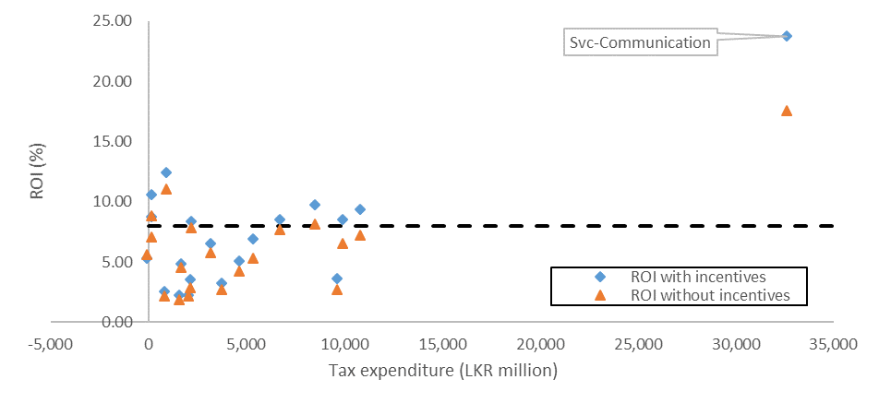
Understanding the impact of Tax Incentives - Firm and Sector Level Analysis
Return on Investment (ROI) is affected positively by tax incentives and pushes sectors above the hurdle rate (makes them profitable), but are clearly redundant for some sectors

Slide 45
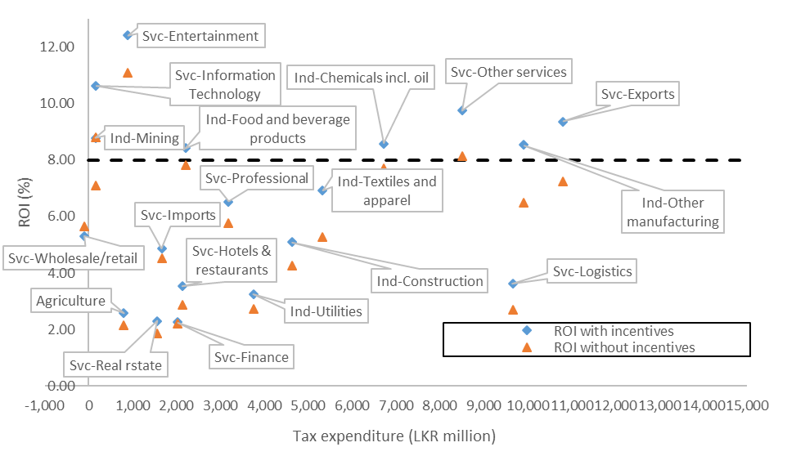
Understanding the impact of Tax Incentives - Firm and Sector Level Analysis
Tax Incentives are beneficial for Exports, other manufacturing mining, food and beverage industry, chemicals and other services as it pushes these sectors above the hurdle rate. Some sectors continue to do badly even with incentives

Slide 46
Econometric evidence using firm level information
METR vs AETR vs Corporate Tax Rate
User Cost of Capital – what is the true cost of $1 of capital investment
If taxes have no impact the cost should remain $1
If there are investment incentives this cost will be less than $1.
What is the elasticity of Investment to User Cost of Capital?
Once we get the elasticity of investment to the user cost of capital we could then estimate the actual investment that has been the result of the tax incentives

Slide 47
Spread in User Cost of Capital – Example South Africa
The User Cost of Capital varies by sectors because of the result of different tax treatment due to different incentives as well as the composition of assets, the cost of each asset affected differently by the tax system

Slide 48
Impact of Tax Incentives – Example South Africa
 | Employment created per million rand in Investment | Additional Investment (in million Rand) | Implied additional Employment | Revenue Foregone | Cost/Job*
Agriculture | 6.6 | 217.4 | 1,441 | 123.5 | 85,701
Construction | 10.7 | 310.3 | 3,333 | 69.0 | 20,704
Manufacturing | 7.9 | 881.8 | 6,922 | 375.8 | 54,293
Mining | 3.8 | - | - | 278.5 | HIGH
Real Estate | 0.3 | - | - | 141.1 | HIGH
Services | 22.8 | 439.2 | 10,019 | 156.7 | 15,639
Trade | 8.7 | 213.2 | 1,844 | 78.3 | 42,431
Transport & Logistics | 1.3 | - | - | 1037.8 | HIGH
Utilities | 0.4 | - | - | 617.3 | HIGH
SBCs | 13.7 | 449.1 | 6,167 | 1055.8 | 171,218
All Sectors | 13.5 | 2,511.1 | 33,874 | 3936.6 | 116,213
Additional Investment as a result of the tax incentives is calculated by using the elasticity of investment to the user cost of capital and the change in user cost of capital as a result of the tax incentives

Slide 49
Policy questions to ask on new Incentives
Would the Investment Come in anyway?
Would the Tax Incentive put existing businesses at a disadvantage?
Would the Investment realize tax revenues after the tax incentives are exhausted?
Does the Investment provide positive externalities?
Direct Jobs
New Technology/Skill up gradation
Import substitution
Infrastructure/Public Goods
New Industry
Spur Ancillary Industries
Does the Tax Incentive create opportunities for Tax Evasion?
Does the Investment cause negative externalities such as pollution?
Would this result in increasing demand for Incentives by other Investors?
In general, few investments satisfy most or all of these criteria. The goal of the Government should be to improve the investment climate and make it conducive for businesses to invest and reduce their costs and make the return profitable. It may be necessary for the government to take a look at the competitiveness of the overall tax system rather than use tax incentives in specific cases to achieve the same end.

Slide 50
Policy Options on the use of Tax Incentives
Use Investment linked Tax incentives rather than Tax Holidays
If using Tax Holidays use at least partial tax holidays (i.e. 50% tax exemption rather than 100%)
VAT incentives are redundant if the system works well
Re-design customs incentives by product rather than by use
Use minimum taxes to minimize loss of tax due to overly generous tax incentives

Slide 51
Thank You

Slide 52
Corporate Tax and FDI
Response of FDI to GDP varies with the region and the response in South Asia is in the opposite direction – more FDI for higher tax rate

Slide 53
FDI in Eastern Europe and Central Asia
FDI is nearly flat with respect to Corporate Income Tax

Slide 54
FDI in East Asia and the Pacific
FDI shows a high response to Corporate Income Tax

Slide 55
FDI in South Asia
FDI goes up with CIT rate – opposite to what is happening in East Asia

Slide 56
FDI in South Asia
FDI has been going down for nearly all countries since 2008

Slide 57
Tax Revenue – South Asia
Pakistan does not collect as much revenue as a percentage of GDP

Slide 58
Tax Revenue is contributed disproportionately by Industry leading to demand for more tax breaks

Slide 59
Questions

Slide 60
Thank You. Sjames2@worldbank.org

